Slide 1
MUSIC RECOMMENDATION SYSTEM

Slide 2
PROBLEM STATEMENT
To build a music recommendation system using machine learning.

Slide 3
OBJECTIVE
The goal of such a recommendation system would be to provide personalized content by rightly identifying what the user wants.
This means that computers will have to think the way humans do; analyzing each of the user’s last choices to predict what they would like in the future.
Therefore, in this project, we will be relying on Machine Learning and Neural Networking techniques to build the ultimate music recommendation system.

Slide 4
METHODOLOGY
Neural Networks
K-means

Slide 5
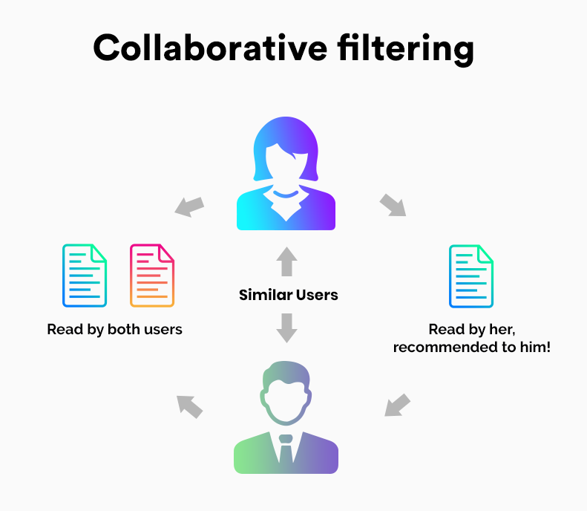
MODULES

Slide 6
TECHNOLOGY USED
Python

Slide 7
THANKYOU

